Slide 1


AZURE WORKSHOP
Welcome to Technology Hub
Full Stack Development
Microsoft AZURE
Azure Devops / Devops
Road maps to All Technology
Interview Questions and answers
Resume Preparation

Slide 2
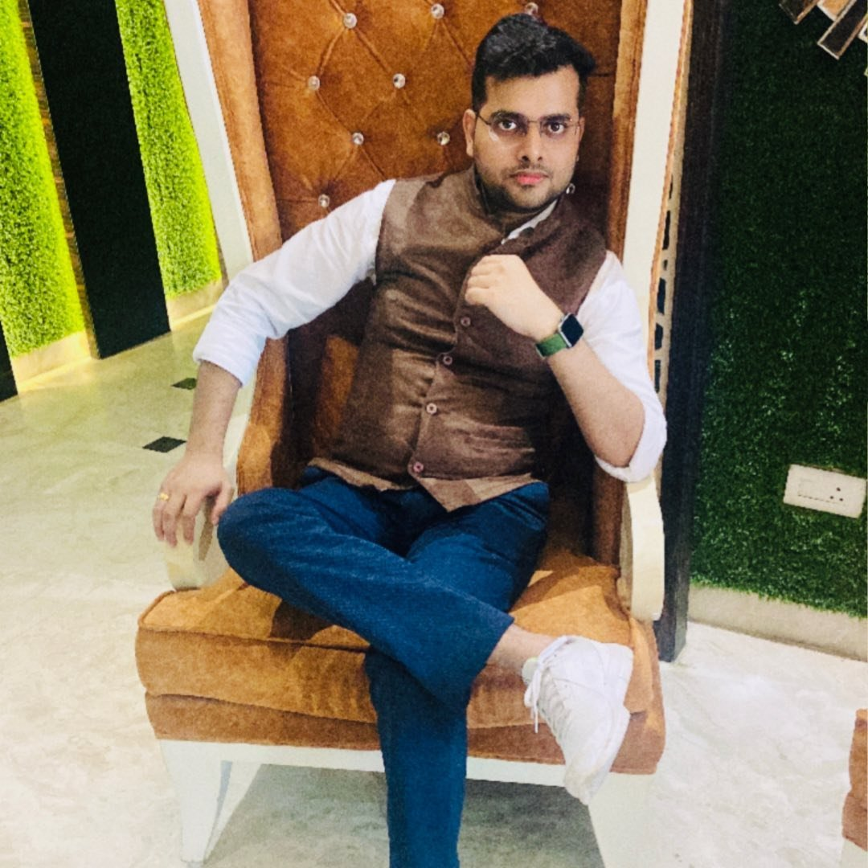
Who am I ?
Present Profile : Assistant Vice President in
Wells Fargo (USA 2nd Largest Bank)
Past Work profile :
Senior Solution Architect (Azure Solution Architect)
Technical Analyst in QATAR AIRWAYS (DOHA , QATAR)
Senior Software Developer in UK E-Commerce giant
#Dreamer #Explorer #Tech Enthusiast
Abhishek Panda (Senior Solution Architect)

Slide 3
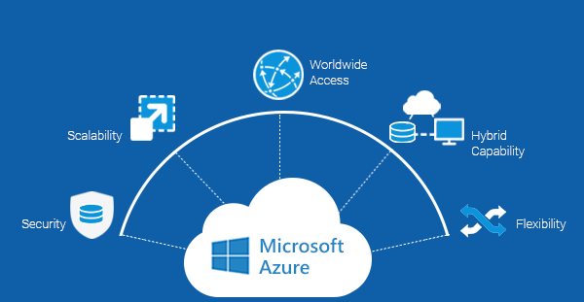
WHY AZURE ?

Slide 4
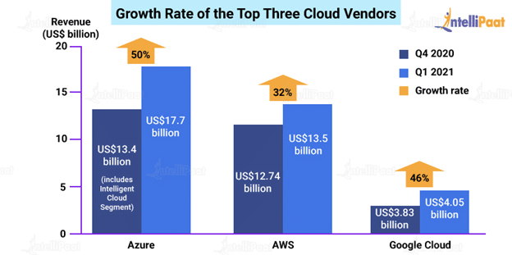
Growth Rate of Azure /AWS/ GCP
Created By : Abhishek Panda

Slide 5
Valuable Azure Customers
Asos
Center of Disease Control (CDC) – US
National Health Service (NHS) – UK
HSBC
Starbucks
Walgreens
3M
HP
Mitsubishi Electric
Renault
Created By : Abhishek Panda

Slide 6
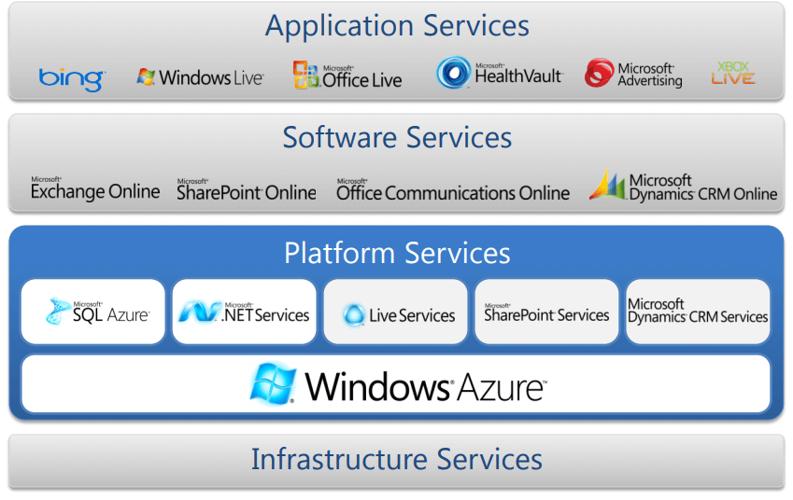
Cloud Service Models
Created By : Abhishek Panda

Slide 7
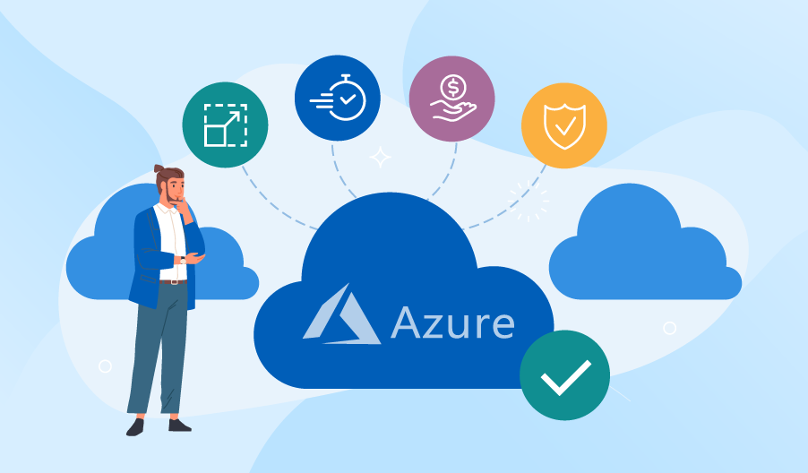
Must DO!!! Azure Certification Road-Map
AZURE Certifications
Az-900
Az-104
Az-204
Az-303/304
Az-400
Created By : Abhishek Panda

Slide 8
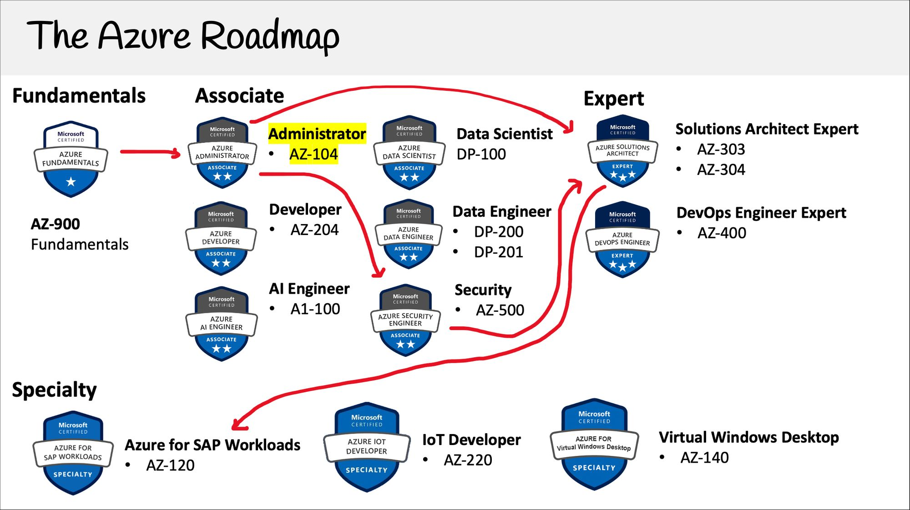
Roadmap to Azure
Created By : Abhishek Panda

Slide 9
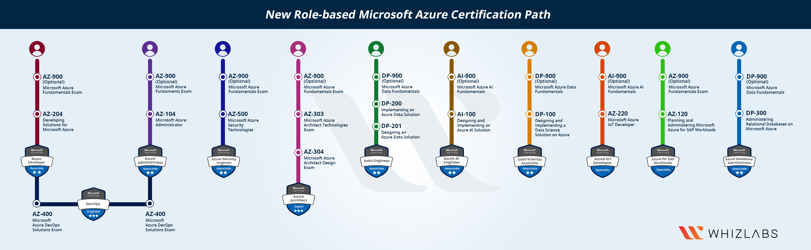
Azure- Certification Path
Azure Certification
Created By : Abhishek Panda

Slide 10
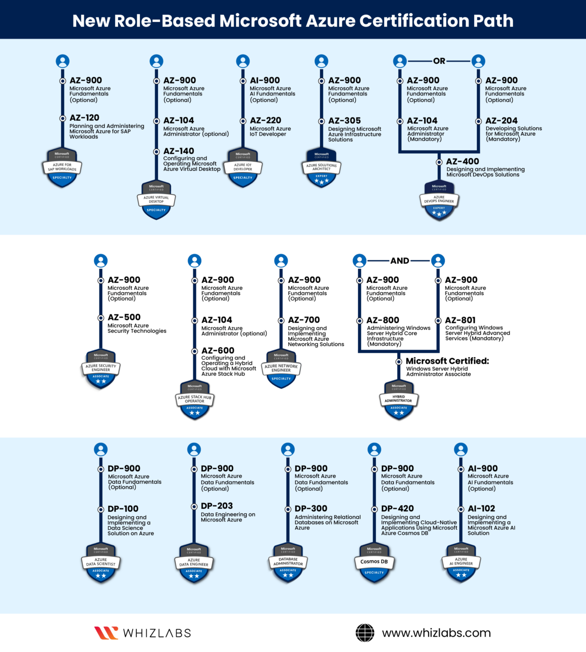
Azure Certification
Azure Certification
Created By : Abhishek Panda

Slide 11
Advance Certification
Microsoft Azure AI Engineer – AI-100.
Microsoft Azure Data Scientist – DP-100.
Microsoft Azure Data Scientist – DP-200 and DP-201.
Microsoft Azure Solutions Architect – AZ-300.
Microsoft Azure DevOps Engineer – AZ-400.
Created By : Abhishek Panda

Slide 12
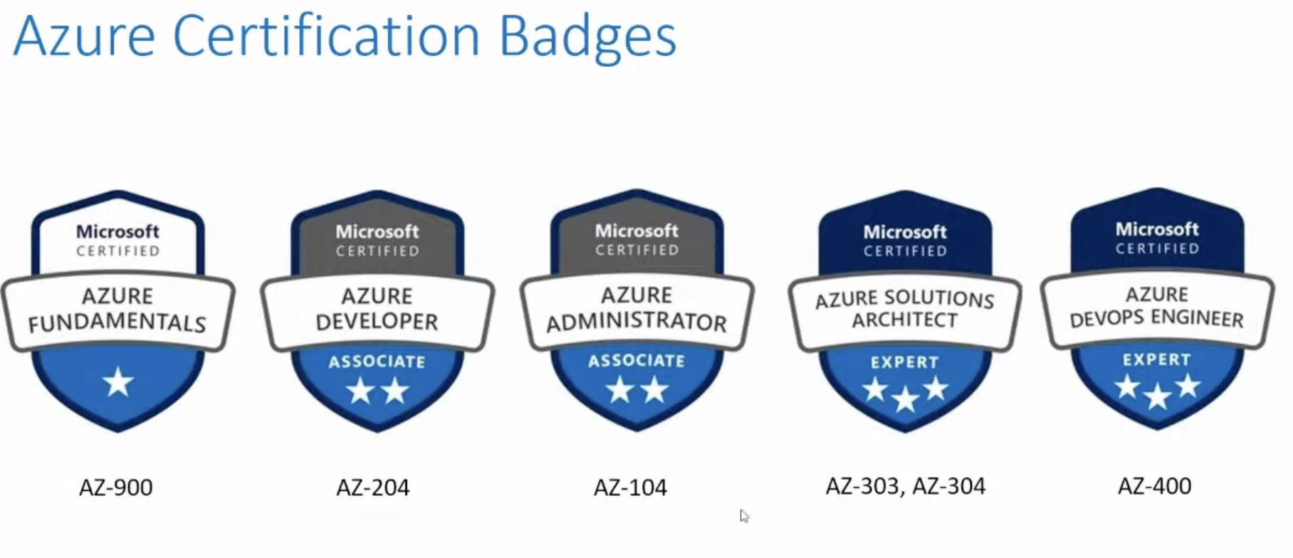
Job Roles and Certification
Created By : Abhishek Panda

Slide 13
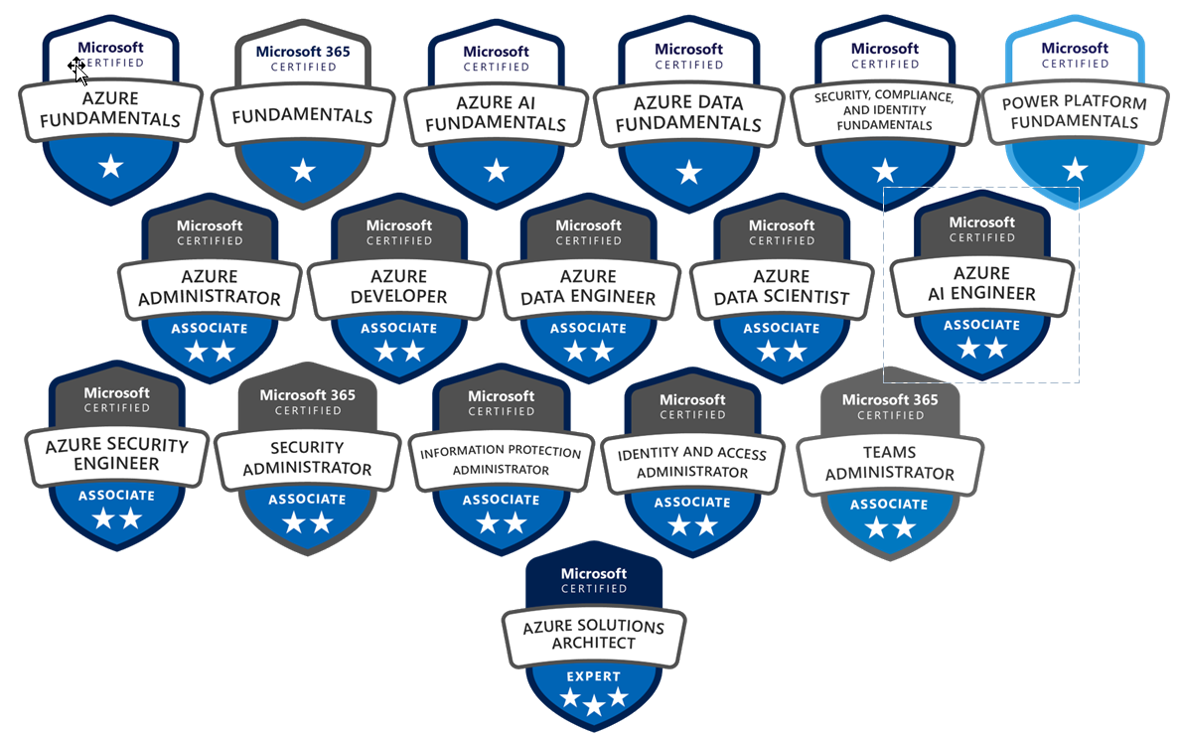
Azure Badges

Slide 14
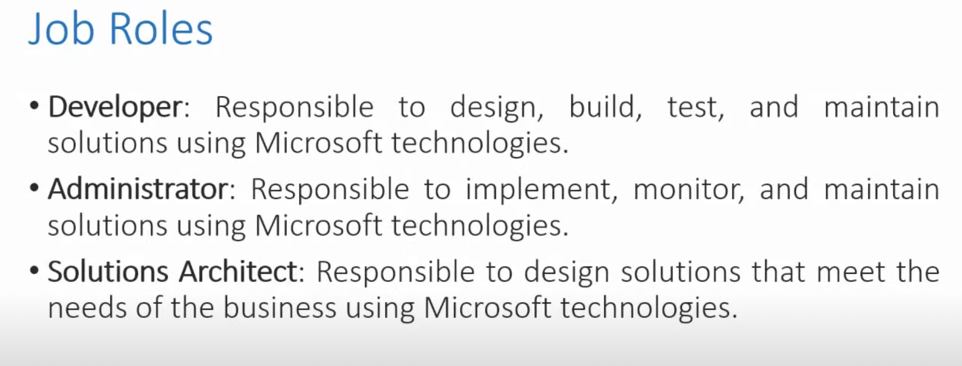
Job Roles and Certification
Created By : Abhishek Panda

Slide 15
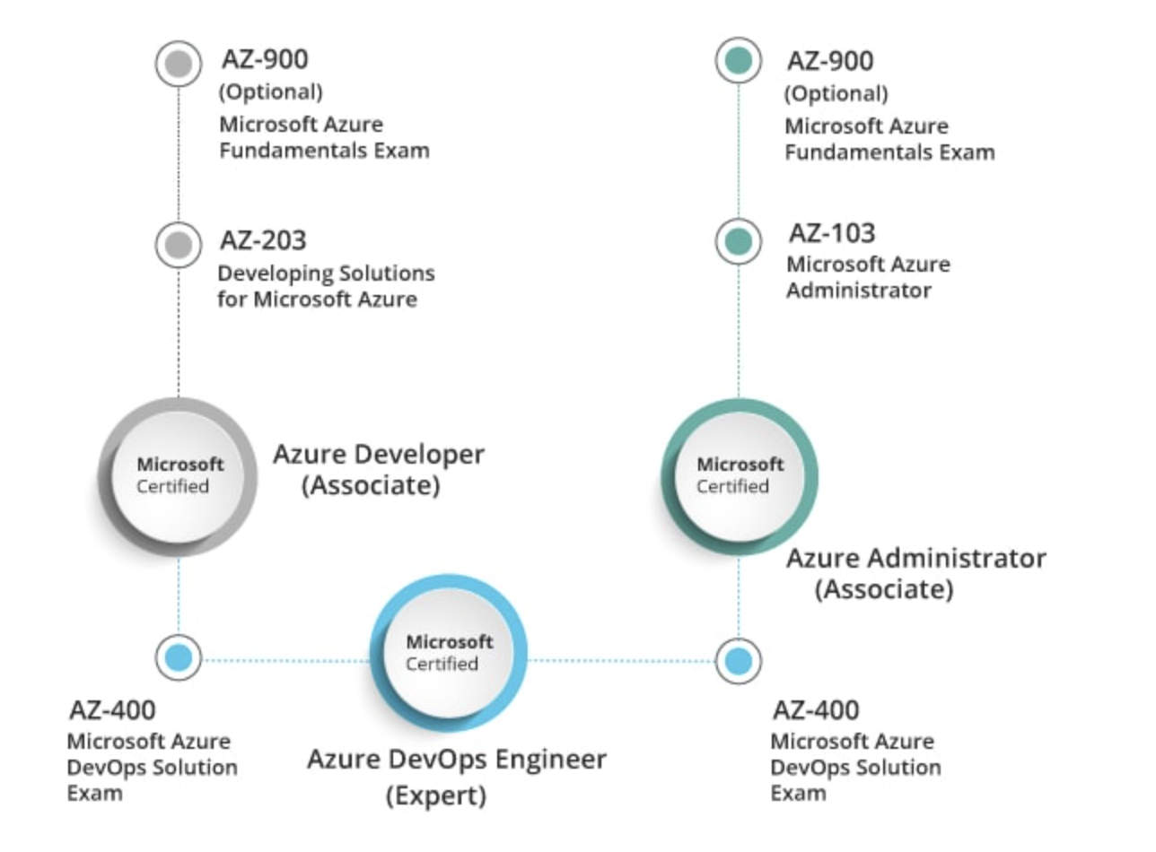
Role Based Certification
Created By : Abhishek Panda

Slide 16
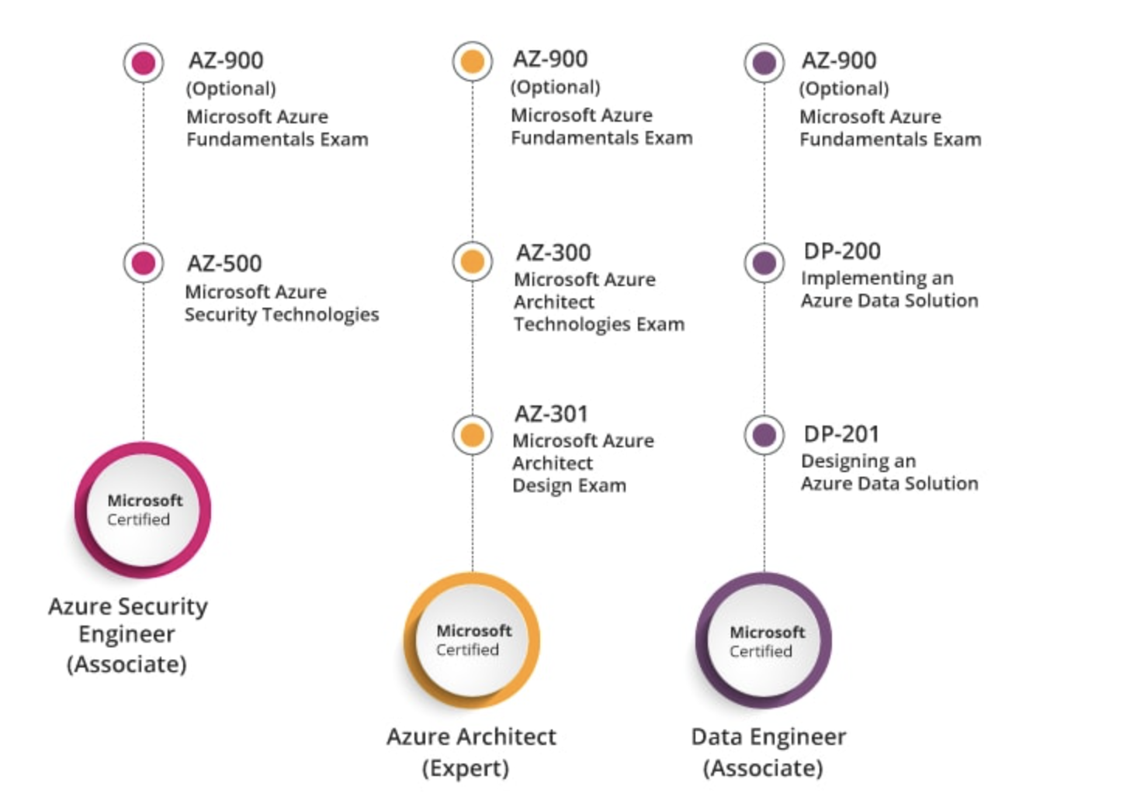
Role Based Certification
Created By : Abhishek Panda

Slide 17
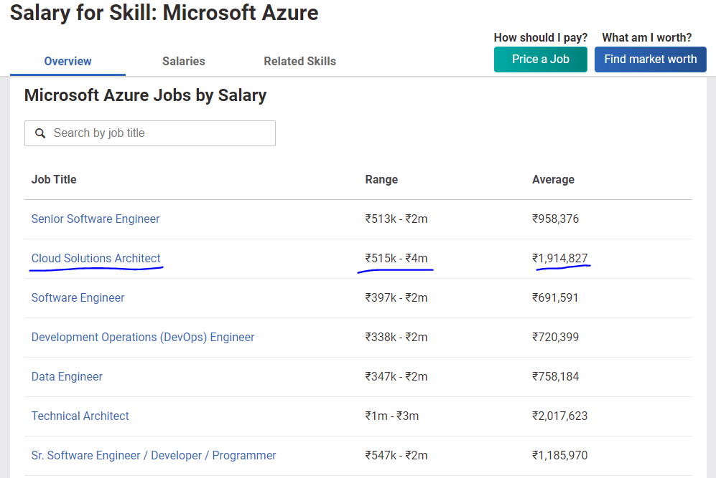
Salary for Azure Certified
https://www.payscale.com/research/IN/Skill=Microsoft_Azure/Salary

Slide 18
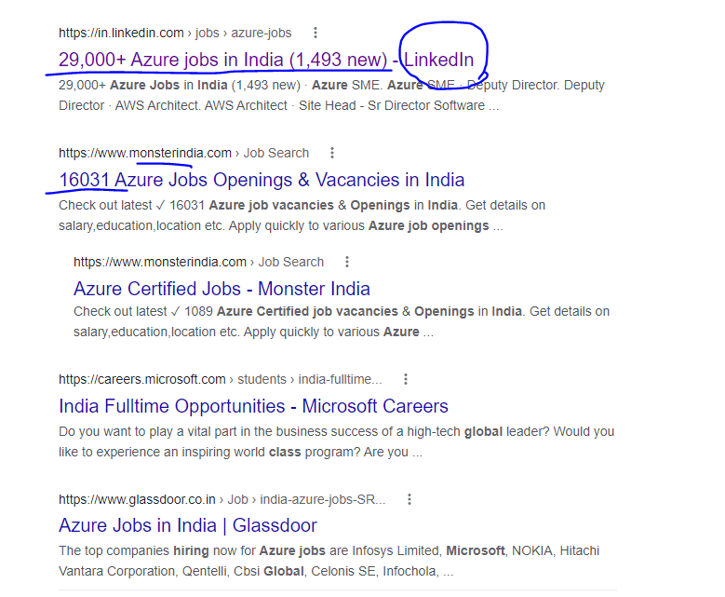
Job Openings for Azure Certified
https://www.naukri.com/microsoft-azure-jobs?experience=0

Slide 19
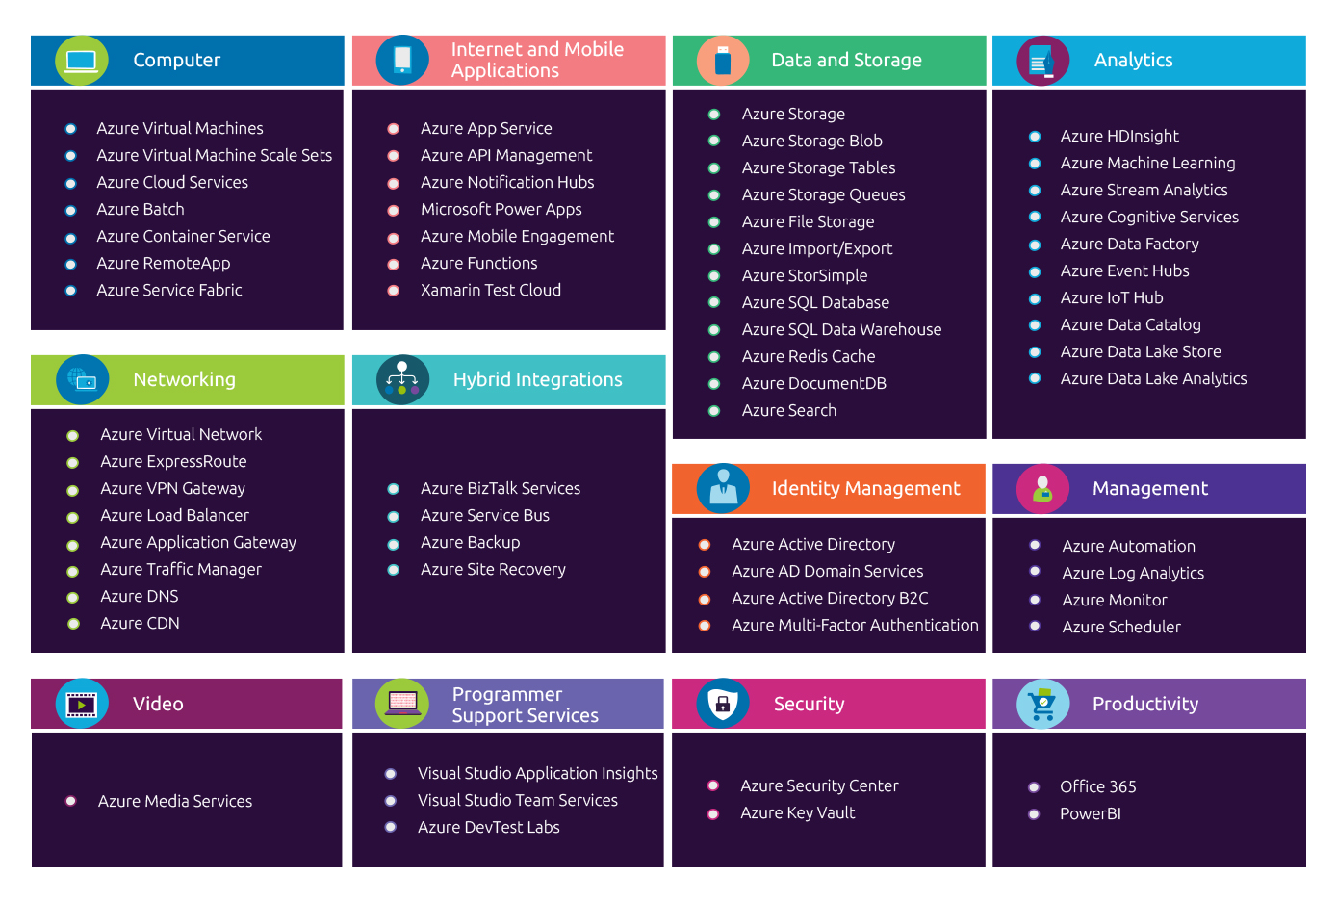
Azure Services

Slide 20
Resources
1. My Blog : https://techsuttabar.com/
2. Azure Service Chart : https://azurecharts.com/overview
3. 3D Azure Data Center Tour : https://news.microsoft.com/stories/microsoft-datacenter-tour/
4. Az-900 Exams Official Link : https://docs.microsoft.com/en-us/learn/certifications/exams/az-900
5. Azure Official documentation : https://docs.microsoft.com/en-us/azure/?product=popular

Slide 21


NEXT Steps ???

Slide 22
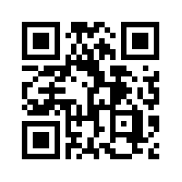
Connect With Me
My Dear Friends ,
Please Connect With me
Facebook : https://www.facebook.com/people/Abhishek-Panda/100072435410563/
Linked in : https://www.linkedin.com/in/abhishek-panda-956312213/
Instagram : https://www.instagram.com/the_abhishekpanda/
Telegram :

